Slide 1
RAC System Concept
Presented By: Team #2

Slide 2
Meeting Agenda
What have we captured?
User stories --------------------------------------
Use case diagrams ----------------------------
Alain’s explanations ---------------------------
Organize user stories / use cases -----------------
Questions for Alain about the system ------------
Discussion -----------------------------------------------
Agile Development ------------------------------------
Andrew ----------------
Max --------------------
Cody -------------------
Brae / Louis ----------
Philip -------------------
All -----------------------
Philip -------------------
X min
X min
X min
X min
X min
X min
X min
This will be filled in after dry run!

Slide 3
RAC Advisor
The RAC Advisor receives applications from the candidates and sends the RAC form to the appropriate Content Specialist(s). The RAC Advisor then meets the candidate and talks about the results and possibilities.

Slide 4
RAC Advisor (cont.)
User Requirements
As a RAC Advisor, I want send a link of a specific RAC to Content Specialists so that they can reviewing them.
As a RAC Advisor, I want to see all RAC requests that were submitted to me, so that I can manage them and start reviewing them.
As a RAC Advisor, I want to be able to modify the status of the RAC so that I can keep track of the progress of the RACs.
As a RAC Advisor, I want to be able to retrieve Candidate’s information so that I can contact them after they are done filling out the RAC.

Slide 5
Content Specialist
The content specialist will review and approve or deny the RAC for their specific department. They will return it to the RAC specialist once they are done.

Slide 6
Content Specialist (cont.)
User Requirements
As a Content Specialist, I want to be able to view the candidate I have been assigned to’s documentation, so that I can confirm or deny the candidate's competencies.
As a content specialist, i want to be able to access the RAC request that was shared to me by the RAC advisor so that i can start my review of the RAC
As a content specialist, i want to be able to leave a RAC and come back with the information i already filled out, so that i don’t have to refill the information i already did.
As a content specialist, I want to send back the RAC request to the RAC advisor once i finish the evaluation, so that the RAC advisor can continue the RAC process

Slide 7
Candidate
The candidate will fill out an application online through their account and submit it to the RAC specialist and wait to have it reviewed. Once the RAC is reviewed, the user will meet with the RAC specialist.

Slide 8
Candidate (cont.)
As a candidate, I want to submit a RAC request so that I can get credited for courses or work experience.
As a candidate, I want to submit a RAC without applying for a college, so that I can decide if I want to apply to the college or not.
As a candidate, I want to be able to easily browse through all courses and competencies so that I can find the one I wish to apply for.
As a candidate, I want to upload my resumes or previous job contracts so that I can prove I place well in the competencies.
As a candidate, I want this system to be mobile responsive so that I can create my profile from my phone or other mobile device.
As a candidate, I want this system to be accessible from anywhere, so that I can create or check my profile from home.
As a candidate, I want my forms to still be there if I have to leave part way through an application so that I don’t need to restart.
As a candidate, I want to be able to review all my submitted RAC requests.

Slide 9
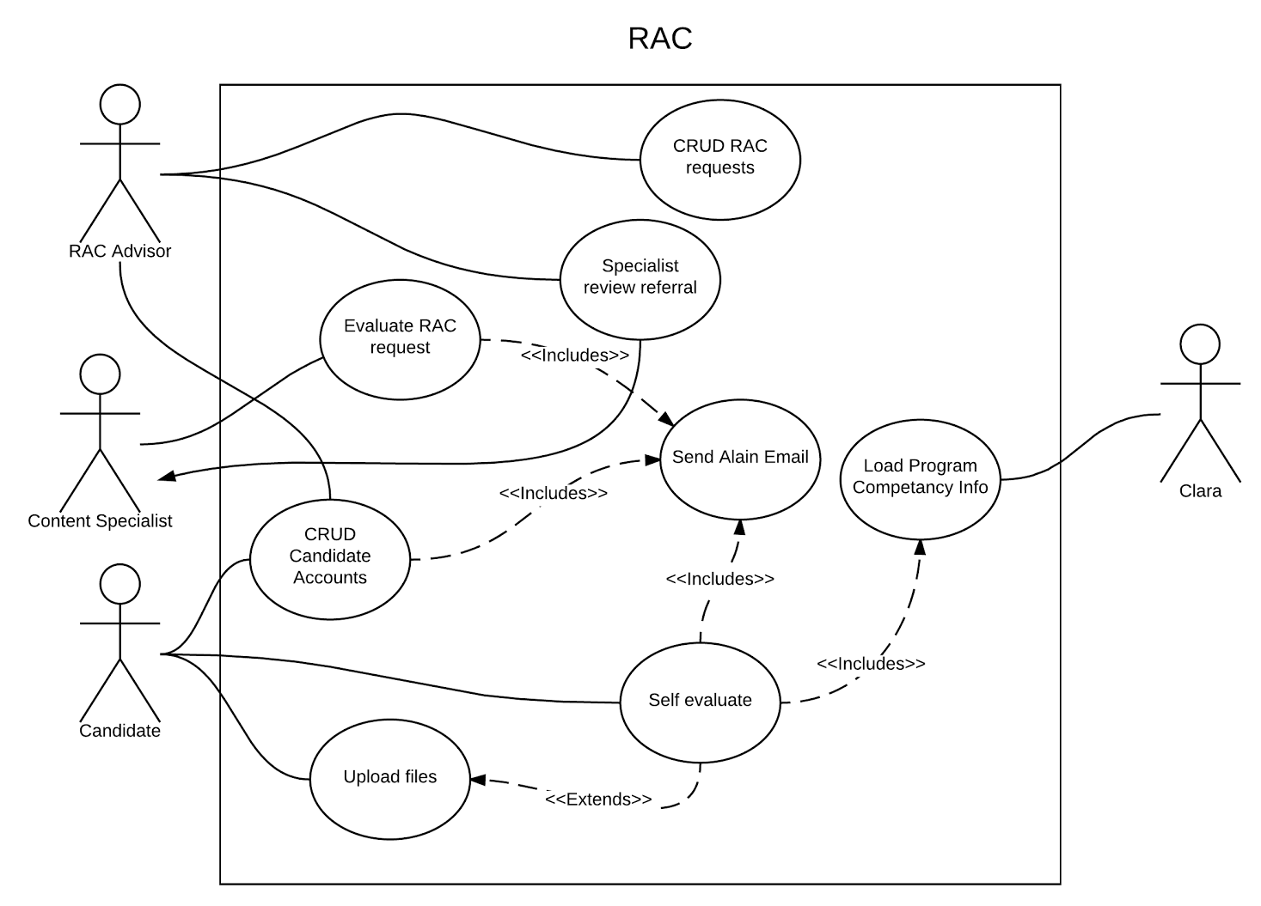
Use Cases

Slide 10
Questions
Can the RAC Advisor evaluate a RAC request (act as a Content Specialist).
If so, can the RAC Advisor also be a Content Specialist.
Does the Content Specialist have an account in the system, and what is an example of their workflow.
Does each actor need full CRUD (Look at Use Case Diagram)?

Slide 11
Prioritising
Let’s take a look at what we have and add some priority.
https://docs.google.com/drawings/d/1TLTyclu3vsZgfy-80qqXuF_7zkfqvvbICWzdb_cnOrQ/edit?usp=sharing

Slide 12
Agile Development
Technical Architecture / Design issues to estimate project size and scope
Project inception deck
For this project we will be approaching it with the Agile style

